Slide 1

Movie Theatre Attendance in Regards to Economic Factors
Movie Theatre Attendance Based on Economic Factors
By: Madison Kerr
By: Madison Kerr

Slide 2
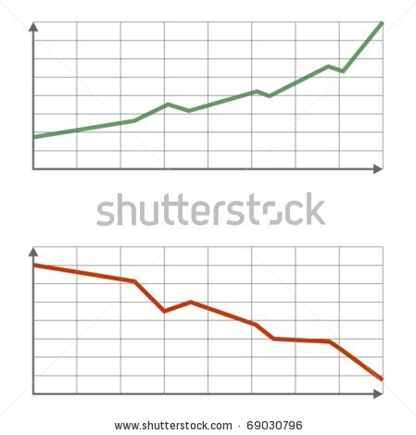
Hypothesis
That movie theatre attendance is not influenced by economic factors.
Movie Industry
Economy

Slide 3


Economic Goods
Two types of goods:
  Normal
    People buy less of in harsh times
  Inferior
    People buy more of in harsh times

Slide 4

Economic Factors vs Movie Attendance
Recession
Real GDP per Capita
Unemployment Rate
Stress Index
Consumer Sentiment
Velocity of Money
S&P 500
Total Public Debt
Disposable Personal Income

Slide 5
Not Normal Data
Probability of Recession

Slide 6
Not Normal Data
Total Public Debt

Slide 7
Not Normal Data
Stress Index

Slide 8
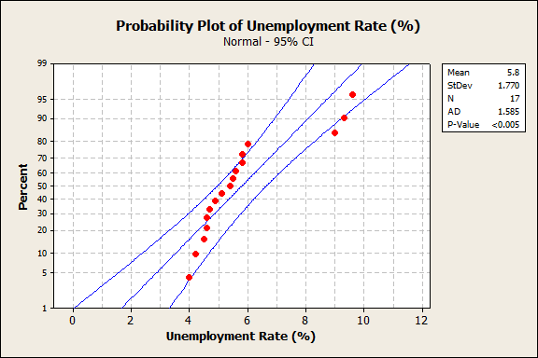
Not Normal Data
Unemployment Rate

Slide 9
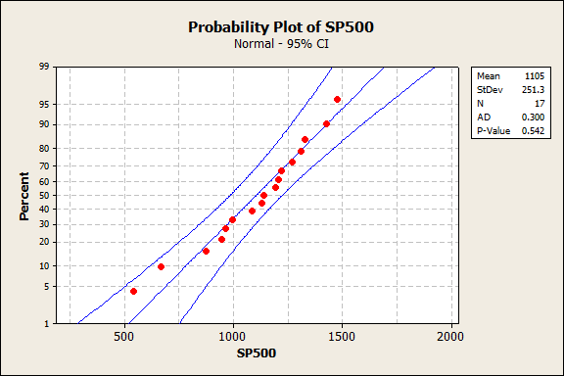
Normal Data
S&P 500 End Values

Slide 10
Parametric vs Non-Parametric Regressions
R sq = 73.9%

Slide 11
Parametric vs Non-Parametric Regressions
R sq= 0.1%

Slide 12
Parametric vs Non-Parametric Regressions
R sq=57%

Slide 13
Parametric vs Non-Parametric Regressions
R sq=8%

Slide 14
Parametric vs Non-Parametric Regressions
R sq=72.7%

Slide 15
Parametric vs Non-Parametric Regressions
R sq=17.6%

Slide 16
Parametric vs Non-Parametric Regressions
R sq=26.8%

Slide 17
Parametric vs Non-Parametric Regressions
R sq=43.9%

Slide 18
Parametric vs Non-Parametric Regressions
R sq=30.2%

Slide 19
Parametric vs Non-Parametric Regressions
R sq=5.1%

Slide 20
Non-Parametric Correlation
  - Kendall
    Null: x and y are independent
    vs
    Alternative: x and y are dependent in some way
    Test stat: Tau
      Tau > 0 = positively correlated
      Tau < 0 = negatively correlated
      Tau = 0 = no correlation

Slide 21
Kendall’s Tau:
Ticket Sales vs…
Recession Prob :
z = 0.414 p-value = 0.6789 Tau = 0.075
Fail to reject null and conclude there isn’t sufficient evidence that there is a correlation between ticket sales and the probability of a recession.

Slide 22
Kendall’s Tau:
Ticket Sales vs…
Real GDP per capita:
z = 0 p-value = 1 Tau = 0
Fail to reject null and conclude there isn’t sufficient evidence that there is a correlation between ticket sales and real GDP per capita.

Slide 23
Kendall’s Tau:
Ticket Sales vs…
Unemployment rates:
z = -0.4968 p-value = 0.6193 Tau = -0.09
Fail to reject null and conclude there isn’t sufficient evidence that there is a correlation between ticket sales and unemployment rates.

Slide 24
Kendall’s Tau:
Ticket Sales vs…
Stress Index:
z = 0.6613 p-value = 0.5084 Tau = 0.119
Fail to reject null and conclude there isn’t sufficient evidence that there is a correlation between ticket sales and stress levels.

Slide 25
Kendall’s Tau:
Ticket Sales vs…
Consumer Sentiment:
z = 0.992 p-value = 0.3212 Tau = 0.179
Fail to reject null and conclude there isn’t sufficient evidence that there is a correlation between ticket sales and consumer sentiment.

Slide 26
Kendall’s Tau:
Ticket Sales vs…
Velocity of money:
z = 0.0827 p-value = 0.9341 Tau = 0.0149
Fail to reject null and conclude there isn’t sufficient evidence that there is a correlation between ticket sales and velocity of money.

Slide 27
Kendall’s Tau:
Ticket Sales vs…
S&P 500 Index:
z = -0.248 p-value = 0.804 Tau = -0.0448
Fail to reject null and conclude there isn’t sufficient evidence that there is a correlation between ticket sales and end value of S&P 500 Index.

Slide 28
Kendall’s Tau:
Ticket Sales vs…
Public Debt:
z = -0.5787 p-value = 0.5628 Tau = -0.1044
Fail to reject null and conclude there isn’t sufficient evidence that there is a correlation between ticket sales and public debt.

Slide 29
Kruskal-Wallis Test
  Kruskal-Wallis
    Null: Tau1 = Tau2 = Tau3 … = Tauk
    vs
    Alternative: Atleast one Tau differs
    Test stat = H

Slide 30
Kruskal-Wallis Results
Because no correlation between any of the variables, it is no surprise that all KW tests resulted in a failure to reject the null hypothesis.

Slide 31


Conclusion
Movie theatre attendance not influenced by economic factors

Slide 32
Works Cited
Economic Data
http://research.stlouisfed.org/fred2/
Movie Theatre Data
http://www.the-numbers.com/market/

